Slide 1
UML502
WebScraping

Slide 2

Scraping Data
What is Web Scraping?
Web Scraping is the automated process of extracting data from websites. It allows access to large amounts of unstructured data.
How the Web Works:
Websites are rendered using HTML
You interact via HTTP requests (GET, POST)
Responses contain structured info (tables, divs, spans)
Legal & Ethical Concerns
Always check the site’s terms of service. Avoid scraping personal or copyrighted content without permission.
Scraping Targets
E-commerce, news, social media, and public records are common scraping targets for ML training data.

Slide 3
Understand HTML Structure
Websites are written in HTML with tags like:
<div> → container
<h1>, <h2>, <p> → text
<a> → link
<table>, <tr>, <td> → tables
Scraping = locating the right tag and extracting text or attributes (href, src, class, id).
Developer Tools (F12) → inspect HTML structure.
https://books.toscrape.com/

Slide 4
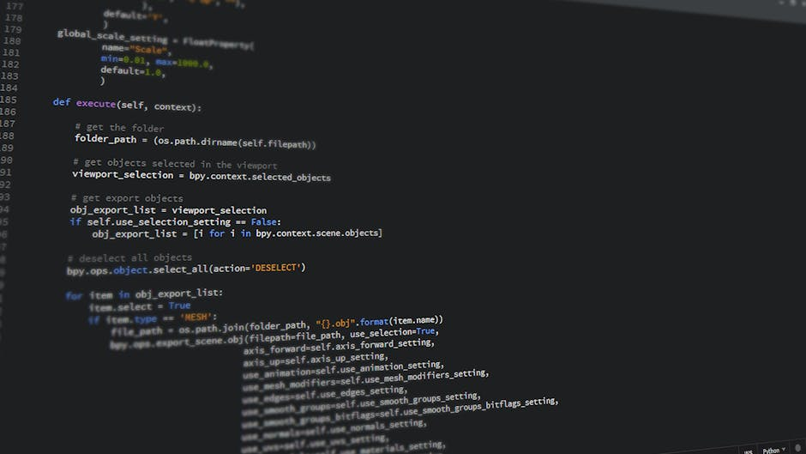
Popular Scraping Libraries
1. Requests: Sends HTTP requests to get HTML of static pages.
import requests
response = requests.get("https://books.toscrape.com/")
html = response.text
Response is an object - <class 'requests.models.Response’ >
which contains:
Status code (response.status_code) → e.g., 200 (OK), 404 (Not Found).
Headers (response.headers) → info about server, content type, cookies.
Content:
response.text → webpage HTML as a string (decoded text).
response.content → webpage content as raw bytes (useful for images/PDFs).
Notes:
.format(page) replaces {} with the current page number.

Slide 5
Popular Scraping Libraries
2. BeautifulSoup (simplest): Parses HTML into searchable objects.
A Python library for parsing HTML and XML. It’s beginner-friendly and works well with static pages.
from bs4 import BeautifulSoup
soup = BeautifulSoup(html, "html.parser")
titles = soup.find_all("h3")
Inspect the HTML (right-click → Inspect Element in browser, or view source).
Confirm which tag contains the titles (h2, h3, span, div, etc.).
Use that in your scraper.

Slide 6
Parser
A parser is a program (or library) that takes raw HTML code (just text) and converts it into a structured tree (like a DOM) that you can navigate easily.
Without a Parser
If you just have HTML as a string:
With a Parser
When you use BeautifulSoup with a parser:
html = "<html><h1>Hello</h1></html>"
print(html[6:10]) # manually slicing → "Hell"
from bs4 import BeautifulSoup
html = "<html><h1>Hello</h1></html>"
soup = BeautifulSoup(html, "html.parser")
print(soup.h1.text) # Output: Hello

Slide 7
Question
<html>
<body>
<h1>Hello</h1>
<p>Welcome to DOM</p>
</body>
</html>
soup = BeautifulSoup(response.text, "html.parser")
soup.h1.text # Hello
soup.p.text # Welcome to DOM

Slide 8
Popular Scraping Libraries
3. Selenium (Used when content loads dynamically via JavaScript.)
Simulates browser behavior and can scrape JavaScript-heavy websites by automating browser interaction.
Needed for dynamic websites (JavaScript-loaded content).
Dynamic page
Page loads with minimal HTML, but content is later filled in by JavaScript (AJAX, fetch API).
Example: Flipkart, Amazon, Twitter.
If you check response.text, it only has a skeleton HTML like:
<div id="products"></div>
<script src="bundle.js"></script>
So Requests + BeautifulSoup won’t work, because they don’t execute JavaScript
https://www.imdb.com/chart/top/

Slide 9
Why Selenium?
Since normal Python libraries (Requests, BeautifulSoup) don’t run JS, we need browser automation or JS-capable scrapers:
Automates a full browser (Chrome, Firefox, etc.).
You can scrape content after it loads dynamically.
Example:
from selenium import webdriver
driver = webdriver.Chrome()
driver.get("https://example.com")
html = driver.page_source
Browser Automation with Selenium:
webdriver.Chrome() opens a browser.
driver.get(url) loads the page.
time.sleep() or WebDriverWait ensures content loads.

Slide 10
Ethics & Legal Side
Only scrape safe websites meant for practice (like BooksToScrape).
Respect website rules:
Don’t overload server (add time.sleep()).
Check robots.txt if unsure.

Slide 11
Data Collection Using APIs
APIs provide structured access to live data streams.
a. Anatomy of an API:
Endpoint: URL for the resource
Method: GET/POST/PUT/DELETE
Headers: Metadata, tokens
Response: Usually in JSON
b. Tools:
requests in Python
tweepy for Twitter
newsapi-python for news articles
c. Example:
import requests
url = "https://newsapi.org/v2/top-headlines?country=in&apiKey=YOUR_KEY"
response = requests.get(url)
data = response.json()
for article in data['articles'][:5]:
print(article['title'])

Slide 12
Challenges in Data Collection
Incomplete data | APIs return partial results
Dynamic websites | Require JavaScript rendering (need Selenium)
Rate limits | Many APIs allow only X requests/hour
Legal restrictions | Data scraping can violate ToS or data laws
Bias | Source of data may skew outcomes
Anonymization | Sensitive data must be stripped of PII (Personally Identifiable Information)

Slide 13
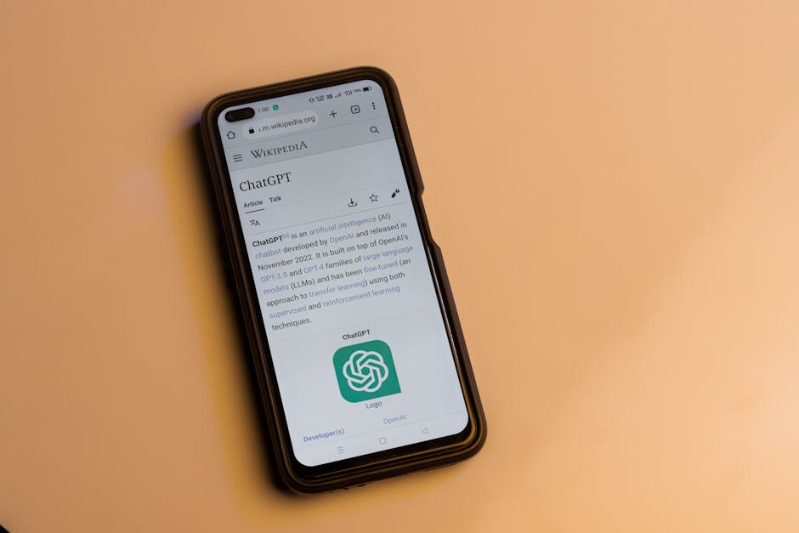
What is Data Annotation?
Why Annotate?
Machine learning models need labeled data for supervised learning. Annotations provide ground truth for training.
Common Types
Classification labels, bounding boxes, segmentation masks, and entity recognition tags are common annotations.
Impact on Accuracy
High-quality annotations lead to better model performance, while poor labeling introduces noise and errors.

Slide 14
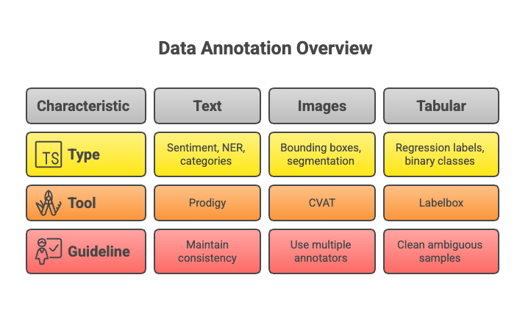
Machine learning models (esp. supervised) require labeled data.
a. Types:
Text: Sentiment, NER, categories
Images: Bounding boxes, segmentation
Tabular: Regression labels, binary classes
b. Tools:
Labelbox (cloud-based)
CVAT (open-source, for images)
Prodigy (for text/NLP)
LightTag (team annotation)
c. Guidelines:
Maintain consistency
Use multiple annotators for reliability
Clean ambiguous samples

Slide 15
Annotation Tools & Methods
Manual Annotation
Platform Solutions
Automation Aids
Tools like LabelImg or VGG Image Annotator are great for small, focused datasets.
Services like Labelbox, Scale AI, and SuperAnnotate offer scalable and collaborative labeling workflows.
Active learning and semi-supervised techniques help reduce human workload and improve speed.

Slide 16
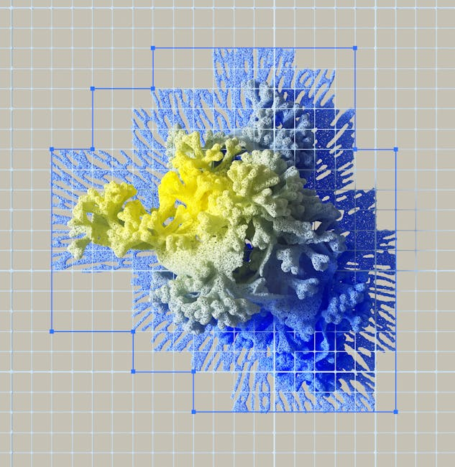
• Always consider data privacy and user consent.
• Respect copyright and licensing restrictions.
• Automate wisely: balance speed with annotation quality.
• Validate data with domain experts when possible.
• Keep a consistent format and schema.
Challenges & Best Practices
Ethical and Practical Considerations

Slide 17
Annotation Strategy
How do you balance data quantity vs. quality?
Discussion & Reflection
Larger datasets may boost performance, but only if the labels are reliable. Prioritizing high-quality, well-annotated data often yields better results in real-world ML scenarios.

